Slide 1
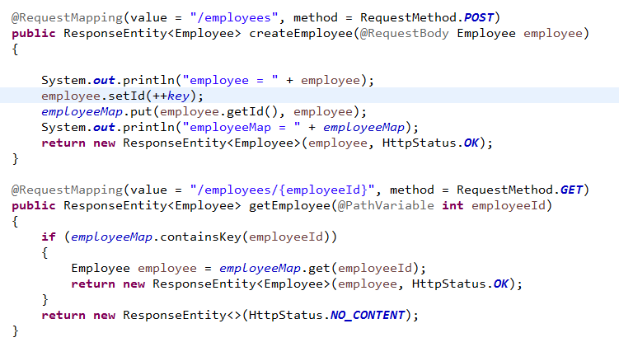
Handle HTTP POST, PUT, Get and Delete Requests - Store Employees Temporary

